Slide 1

SC1015
Mini Project
Presentation
SC1015
Mini Project
What Makes a Business Stay Open?
FCSA | Team 3
Zhu Zhanyan
Lim Li Ping Joey
Roger Kwek Zong Heng
Notes:
Greetings, our group consists of Joey, Roger and Me Zhanyan. Today we will be answering the question,”What Makes a Business Stay Open?”

Slide 2

SC1015
Mini Project
Presentation
PROBLEM STATEMENT
The Motivating data science problem.
DATA PREPARATION
How we prepared the data.
EXPLORATORY DATA ANALYSIS
Elaborate on what you want to discuss.
MACHINE LEARNING
Machine Learning modeling process.
TABLE OF CONTENTS
INSIGHTS & RECOMMENDATION
Elaborate on what you want to discuss.
Notes:
Here is an overview of what we are covering today.

Slide 3

SC1015
Mini Project
Presentation
Problem Statement
Notes:
First let me talk about the problem we are are trying to solve.

Slide 4


SC1015
Mini Project
Presentation
What Makes a Business Stay Open?
Problem: We want to start a business but no idea how to make it survive.
Make data-driven decision on what to implement in business.
Data Science Problem: Binary Classification
1 This business is still open.
0 This business has closed.
Notes:
Imagine you want to start a business but you ain't got the faintest idea of what it takes to make sure it survives
What makes a Yelp business stay open?
Lets frame this into data science problem so that we make a data driven decision on what to do.
The question fits naturally into a Binary Classification problem
0 This business has closed
1 This business is still open

Slide 5
SC1015
Mini Project
Presentation
Data
Preparation
Notes:
Next, I will talk about the dataset used in our project.

Slide 6




SC1015
Mini Project
Presentation
Yelp Dataset
6,990,280 reviews
150,346 businesses
11 areas in US
Notes:
To answer the question, we will be using a dataset provided by Yelp. This dataset is a subset of user-submitted data on the Yelp online review platform for academic research.

Slide 7
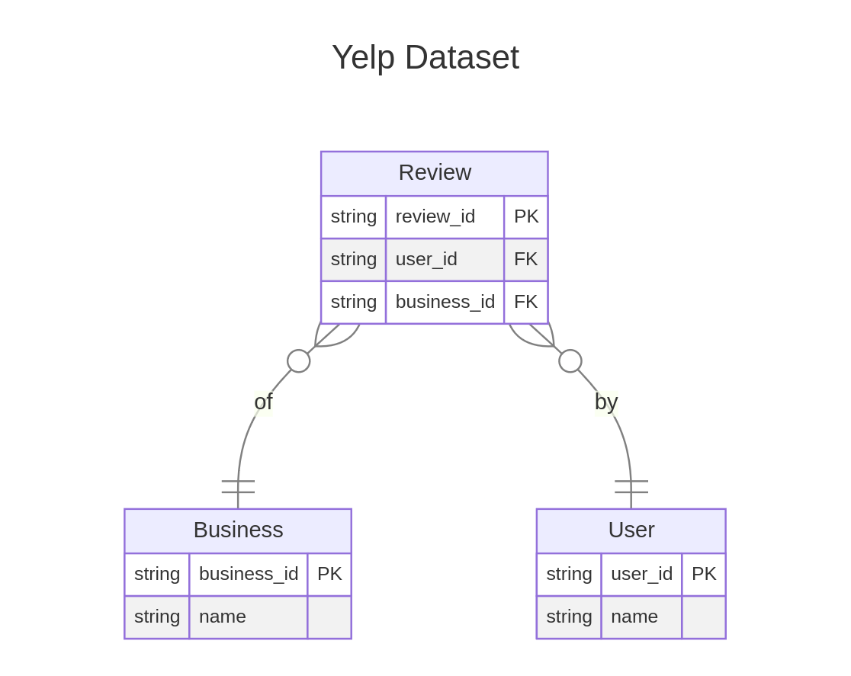
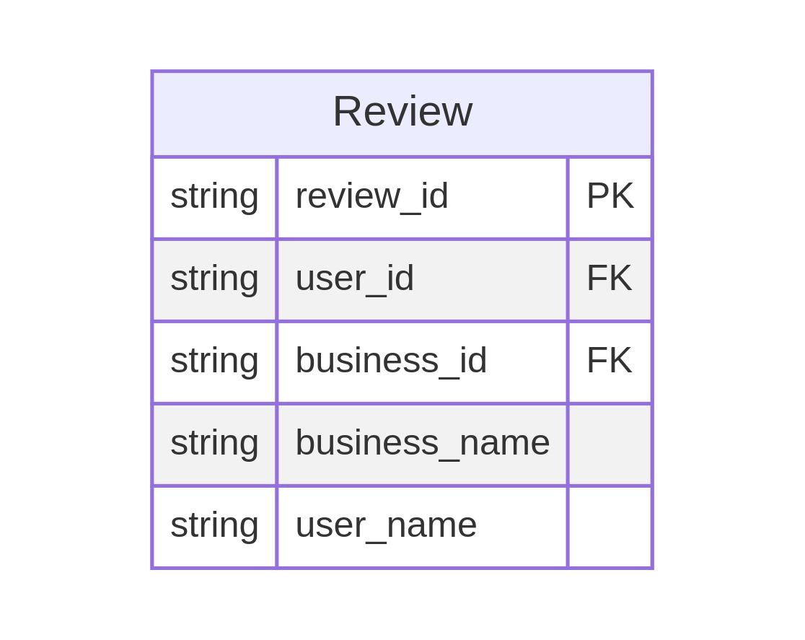
SC1015
Mini Project
Presentation
Sampling & Denormalization
Volume Too large to analyse on single machine.
Sampling performed on dataset to reduce dataset size for analysis
Denormalization of table to table relationships to form "one wide table" of data for ease of analysis.
Denormalization
Notes:
In its original state, the Yelp dataset is not suitable for analysis as its relatively large. The full dataset cannot be loaded on a single machine. So we Sampling of the last 100 thousand reviews by review timestamp to reduce the data to a manageable size suitable for single node processing
Additionally, denationalisation of relationships is performed to form "one wide table" of data for ease of analysis.

Slide 8
SC1015
Mini Project
Presentation
Exploratory Data Analysis
Notes:
Moving onto the Exploratory Data Analysis we did.

Slide 9
SC1015
Mini Project
Presentation
Subquestions
Do Closed businesses have more negative reviews?
Do Open businesses have more reviews than Closed businesses?
What do people say about businesses that are Opened vs Closed?
Does the category of the business affect whether it will remain open?
Does location affect whether a business remains open?
Notes:
To answer what makes a business stay open, we will first address 5 subquestions. We will be explaining our EDA along with the subquestions.

Slide 10
SC1015
Mini Project
Presentation
Sentiment Analysis
Notes:
The first part of the EDA will focus on sentiment analysis

Slide 11
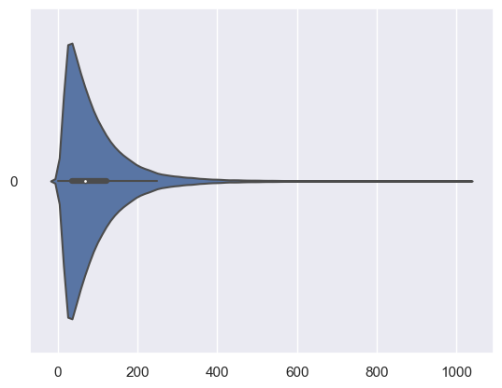
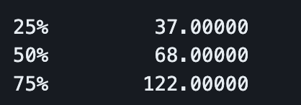
SC1015
Mini Project
Presentation
Length of Reviews
Notes:
The first thing we did was to check the length of reviews.To determine this, we counted the number of words separated by spaces. We can see that the length of reviews is around 30 to 100 words, which is very short.

Slide 12

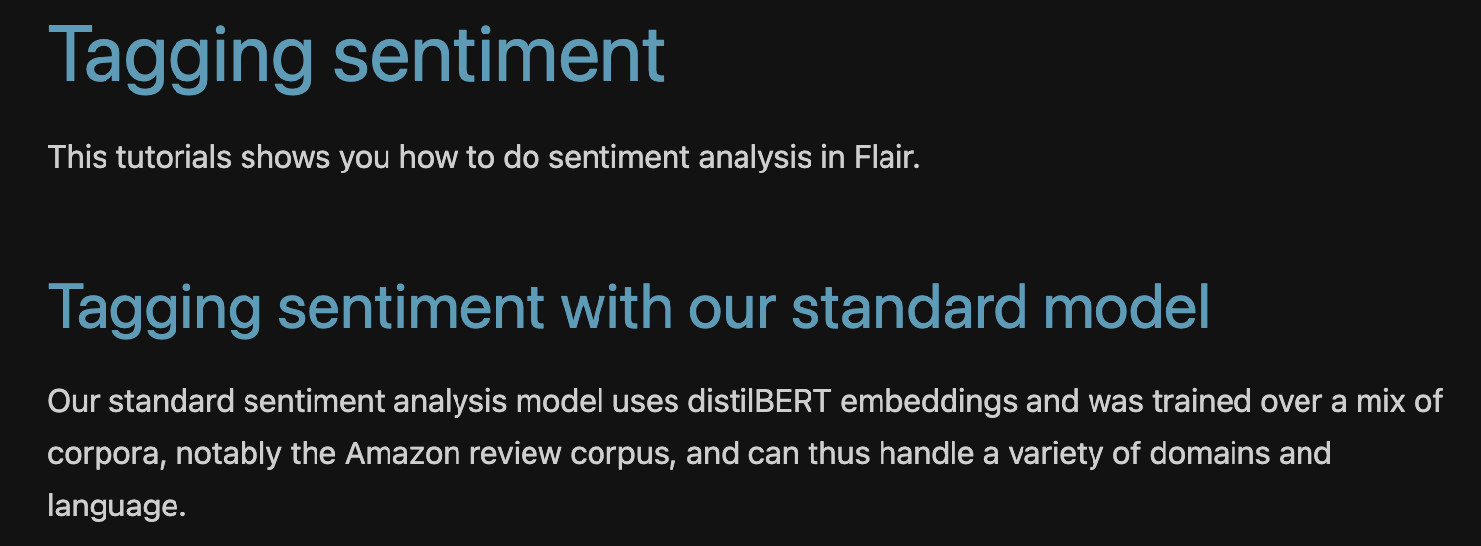
SC1015
Mini Project
Presentation
Model Used
Notes:
Since the nature of the text data was business reviews, and the length of the reviews were short, we decided to use a deep learning model to do the sentiment analysis. We chose Flair because it is a State of The Art model and it was trained over movie and product reviews. Flair returns a sentiment value which indicates whether a piece of text is negative or positive.

Slide 13
SC1015
Mini Project
Presentation
Q1. Do Closed Businesses Have More Negative Reviews?
Q2. Do Open businesses have more reviews than Closed businesses?
Notes:
The first two questions we will answer is, do closed businesses have more negative reviews? and do open businesses have more reviews than closed businesses?

Slide 14
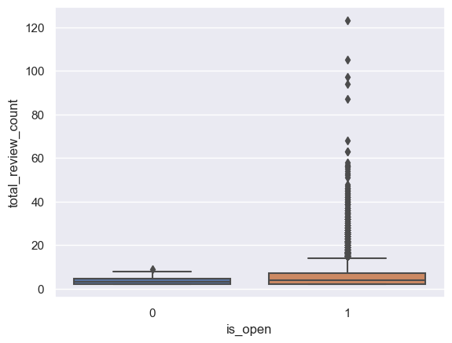
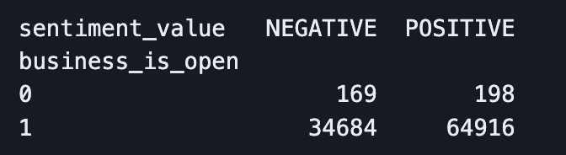
SC1015
Mini Project
Presentation
Verdict
It is difficult to conclude that closed businesses have more negative reviews
Total number of reviews for closed businesses is significantly lower than open businesses
According to the crosstab, open businesses have significantly more reviews than closed businesses
Notes:
According to the box plot, we can see that for some reason, open businesses have a lot of outliers in the number of reviews each business has, whereas the number of reviews for each closed business seem to be very close to each other.
Upon closer investigation, the crosstab reveals that closed businesses actually have significantly fewer reviews than open businesses. Technically, the open businesses have significantly more negative reviews.
However, the number of reviews for open businesses is significantly more than the closed businesses
Hence, it is difficult to conclude that closed businesses have more negative reviews.
The crosstab also answers the 2nd question. There are significantly more reviews for open businesses as compared to closed. This suggests that there is relation between the number of reviews and whether a business is open.

Slide 15
SC1015
Mini Project
Presentation
Q3. What Do People Say About Businesses that are Open vs Closed?
Notes:
The third question we will answer is a bit more interesting. What do people say about businesses that are open vs closed? To answer this, we would need to see what are the common words used in reviews, or otherwise known as Term Frequency Analysis, or TF Analysis

Slide 16
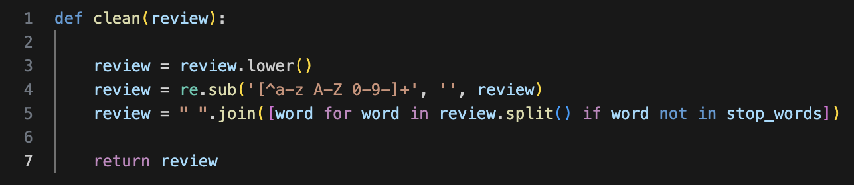
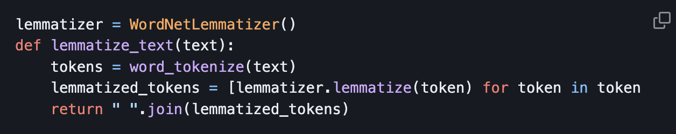
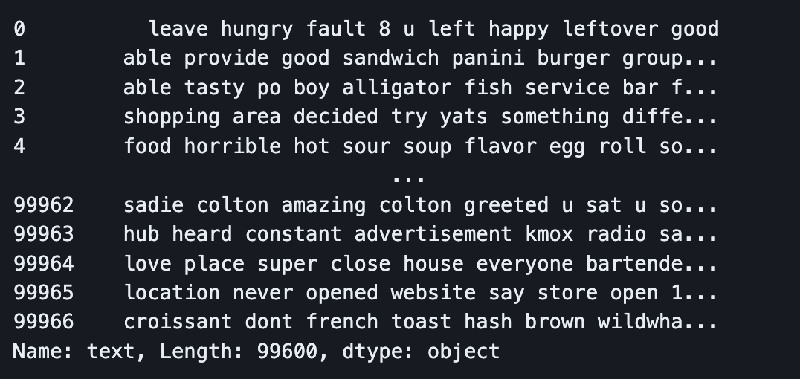
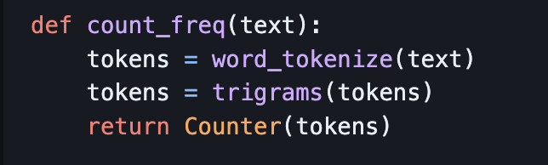
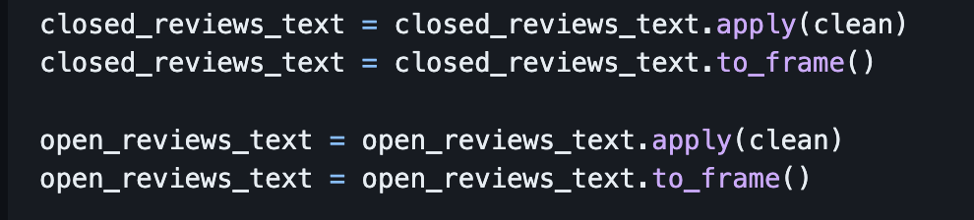
SC1015
Mini Project
Presentation
Cleaning Text Data
Getting Rid of Stopwords/Punctuations/
Lowercase Conversion
Lemmatisation
Trigrams
Notes:
But before we even count how frequent a word gets mentioned, we will need to clean the text data first.
We standardised everything to lowercase and got rid of stopwords, because we know that words the “the”, “as” and “of” and punctuations are not very useful in our analysis.
After removing stopwords, we performed lemmatisation, which is the process of grouping words that are derived from the same word. For example, the words “eat”, “eaten” and “eating” are all different forms of the same word, and we want to count them as the same.
The last thing we did to clean the data was to group the words into trigrams to hopefully get more context into the frequent terms as opposed to just individual words

Slide 17
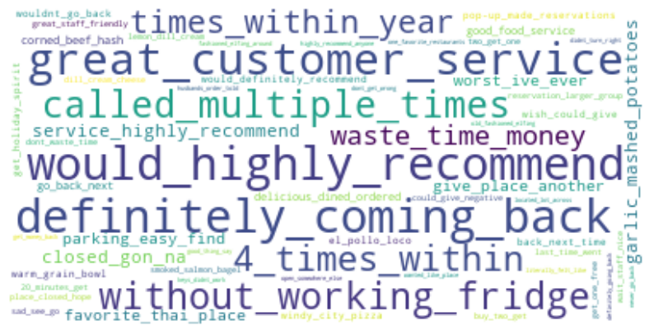
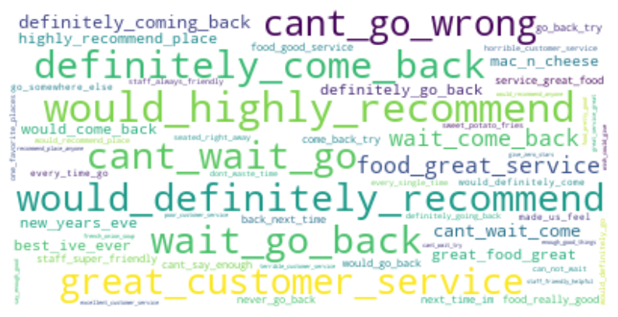
SC1015
Mini Project
Presentation
Term Frequency Analysis
Closed Businesses
Open Businesses
Notes:
Moving onto the actual TF Analysis, we plotted the following wordclouds.
We realise there are some overlap in what people say about closed and open businesses such as “would_highly_recommend” and “definitely_coming_back”

Slide 18
SC1015
Mini Project
Presentation
Term Frequency Analysis
Closed Businesses
Open Businesses
Notes:
However, for closed businesses, there are some negative trigrams such as “waste_time_money”, “worst_ive_ever” and “without_working_fridge”

Slide 19
SC1015
Mini Project
Presentation
Verdict
Open Businesses | Closed Businesses
Reviews were POSITIVE Mentions Good Food and Customer Service | Reviews were POSITIVE and NEGATIVE Mentions Good Food and Customer Service Mentions a waste of time & money Mentions about the place not having a working fridge
Food was mentioned very frequently Suggests many businesses are food establishments or providing food
Notes:
So, to answer the question of what do people say about businesses that are open vs closed, we saw that reviews for the open businesses were very positive, whereas closed businesses had a mix of positive and negative reviews
the reviews for open and closed businesses focused on the good food and customer service.
however, the negative reviews for the closed businesses talked about the business being a waste of time and money and how the places did not have a working fridge
interestingly, food was mentioned very frequently. this suggests that many of the businesses are providing food, or maybe they are actually food establishments. This claim will be further explored by Roger.

Slide 20
SC1015
Mini Project
Presentation
Q4. Does the Category of the Business Affect Whether it will Remain Open?
Notes:
For our 4th question, Does the category of the business affect whether it will remain open?

Slide 21
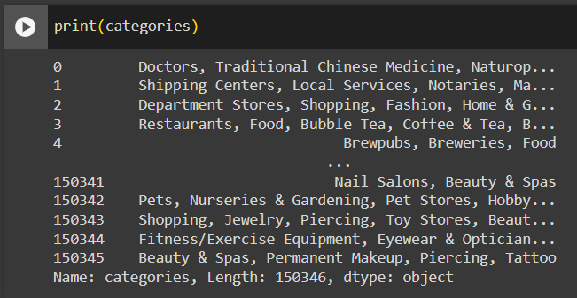
SC1015
Mini Project
Presentation
Categories
Total number of unique categories : 1312
Notes:
We first look at the different type of categories that the dataset had and surprisingly there were 1,312 different unique categories and each business can have multiple different categories tag to it as well.
So we will need to scale the categories down and determining how we can have general main categories for each business for easier analysis

Slide 22
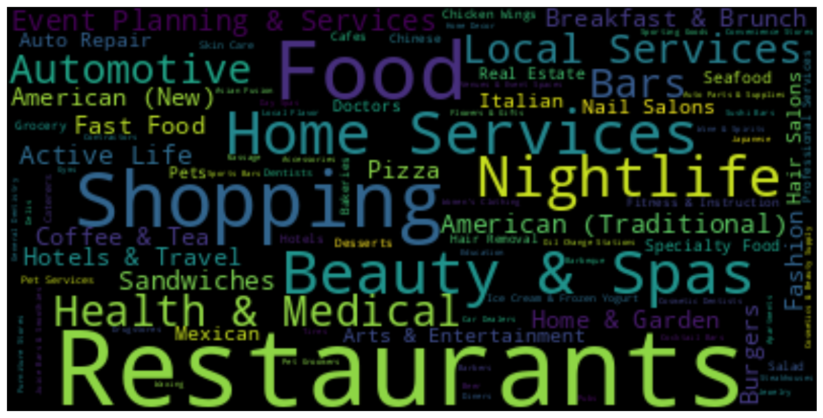
SC1015
Mini Project
Presentation
Finding Main Categories
Wordcloud
Notes:
We first explore using wordcloud to try and find frequent category words in the dataset and we can observe that categories like Restaurants, Food, Shopping, Nightlife, Beauty & Spas are the frequent categories used.
However we can’t fully determine based on this wordcloud on the possible main categories that we can extract for our analysis as most of the visible big words in the wordcloud are related to foods and restaurants and other kind of categories are being flooded out.
So we will have to try other methods to determine our main categories

Slide 23
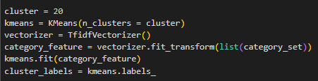
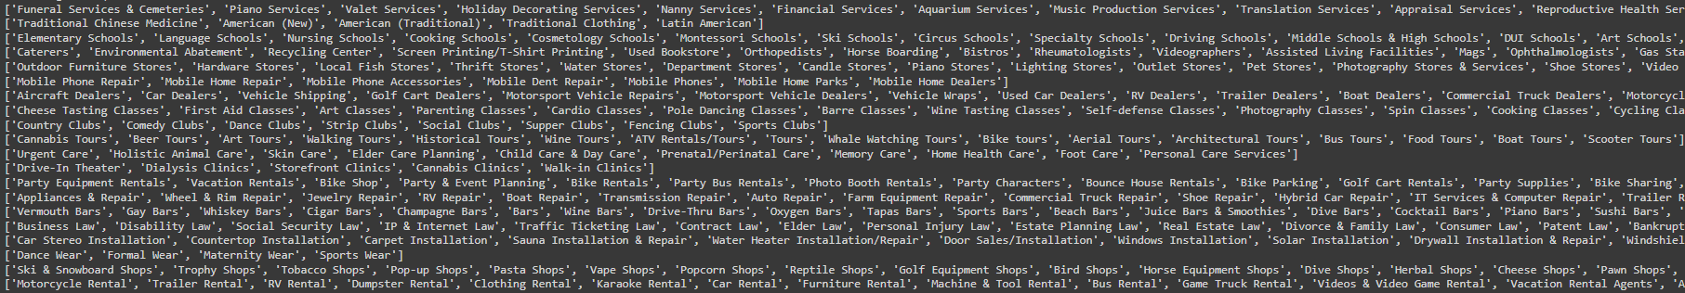
SC1015
Mini Project
Presentation
Finding Main Categories
K-Means Clustering
Notes:
Which leads us to trying K-Means Clustering. We explored using k-means clustering to see if it could cluster any similar categories together to help us determine the main categories. And truthfully it work but there were many clusters that were not clustered well and the remaining categories that the k-means were not able to cluster were clustered into one. So it was still hard for us to extract out the main categories and we decided to search online for possible extraction of yelp main categories

Slide 24
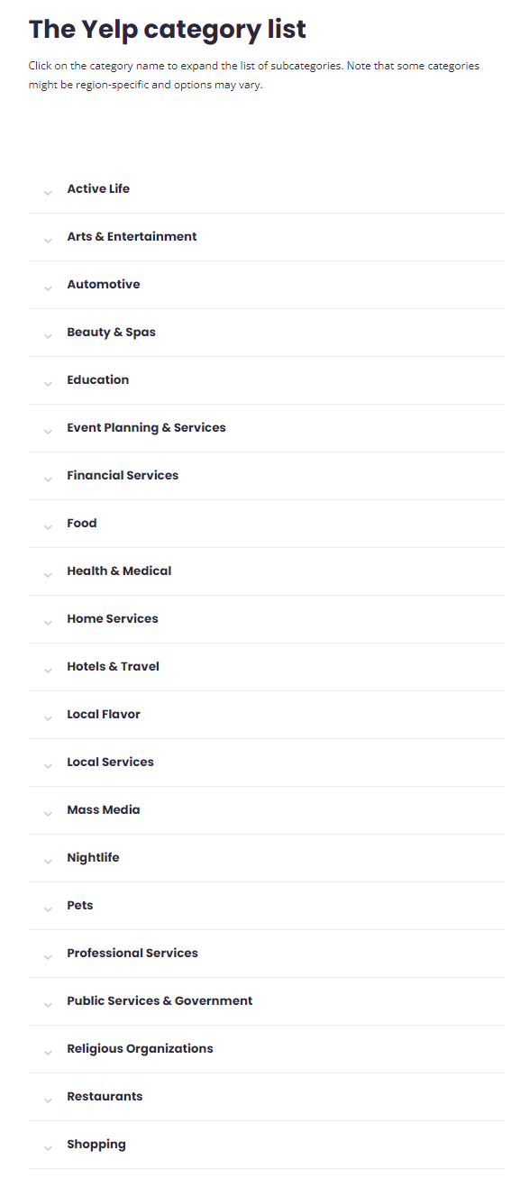
SC1015
Mini Project
Presentation
Finding Main Categories
Yelp Dataset Website
Notes:
And thankfully there was one with all the categories nicely categorised into Main Categories. And we work from there to do our analysis

Slide 25
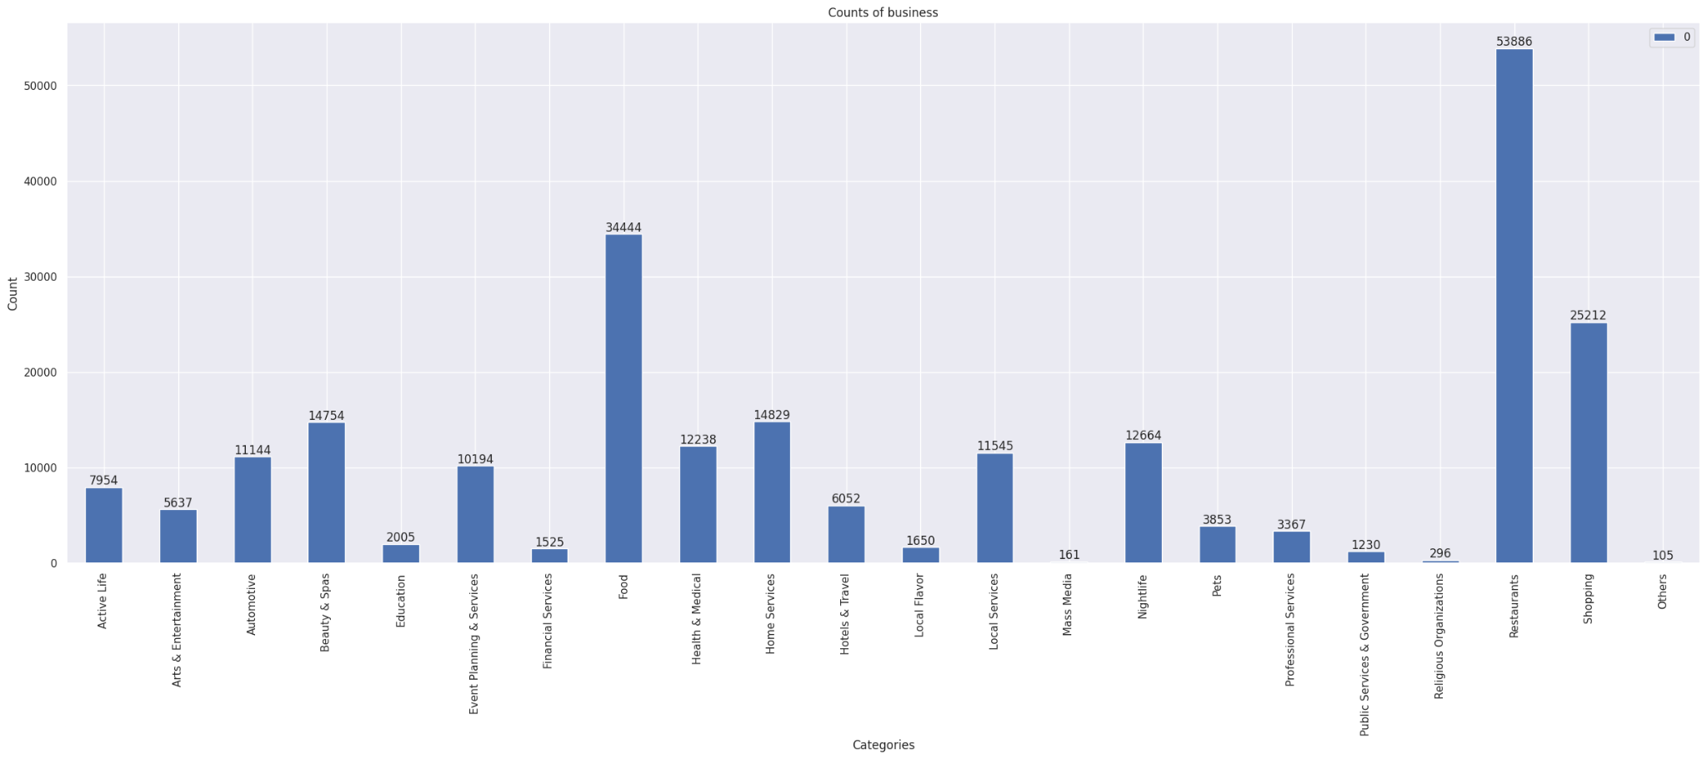
SC1015
Mini Project
Presentation
Number of business per category
Notes:
We start off by plotting a bar chart on the number of business per categories and we can clearly see which are the most popular categories businesses and which are the least popular categories.

Slide 26
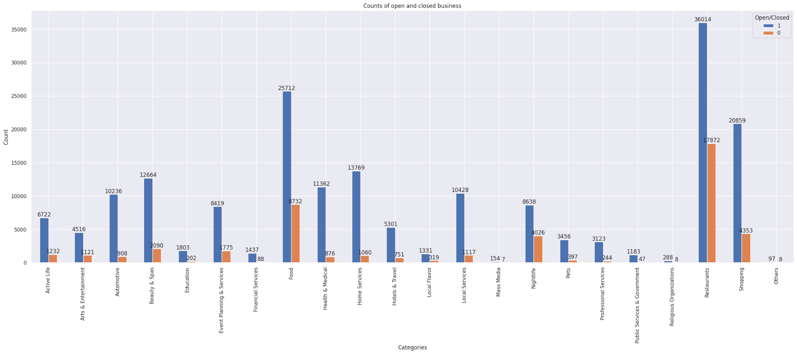
SC1015
Mini Project
Presentation
Number of open/closed business per category
Notes:
We further explore the categories by splitting each categories into whether its open or closed. So now we can see that Restaurants and Food has the higher number of business open and closed as well. But we can deduce that the reason to high business closed might be correlated to the high number of business count in that categories. So we would want to see the ratio between the open businesses and total number of businesses for each category.

Slide 27
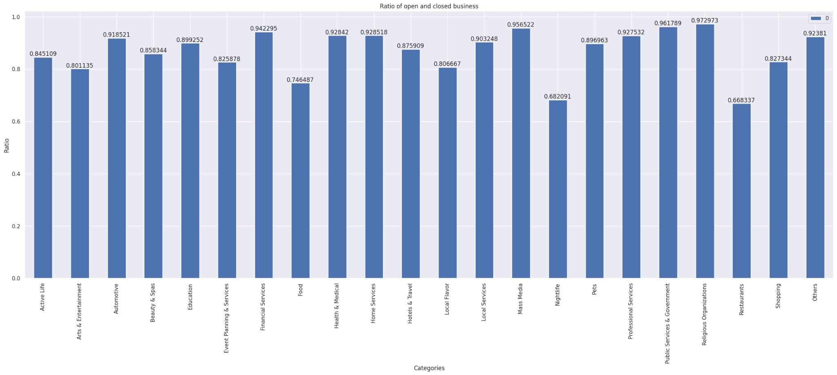
SC1015
Mini Project
Presentation
Ratio of open business per category
Notes:
And based on this ratio, we can see that Religious Organizations, Public Services & Government, and Mass Media has the highest ratio of businesses to remain open while Restaurants, Nightlife, and Food has the lowest ratio of businesses to remain open.
But comparing between the ratio and the business count, we can generally see the trend where with a low business count in that category, they will have a higher ratio while having a higher business count will result in a lower ratio.

Slide 28
SC1015
Mini Project
Presentation
Verdict
HIGHEST POSSIBILITY
TO OPEN
HIGHEST POSSIBILITY
TO CLOSE
Religious Organizations
Public Services & Government
Mass Media
Food
Nightlife
Restaurants
Unable to properly conclude
Possibility to open/close relates to Number of business
Notes:
Overall, it is hard for us to properly conclude on whether the category of business will affect whether it will remain open or not
Even though there is a high business count in one category, it will logically shows that there is a higher possibility for that category to close as well due to competitiveness, like Food & Restaurants, while having low business count in one will show that there is a high possibility to remain open, because there is less competition, like Religious Organizations & Mass Media.
So it will be best to choose a business category where it has a balance in both the number of business open and the possibility for it to remain open when one is choosing to open a business, like Shopping & Home Services

Slide 29
SC1015
Mini Project
Presentation
Q5. Does Location Affect Whether a Business Remains Open?
Notes:
Lastly our final question, Does location affect whether a business remains open?

Slide 30
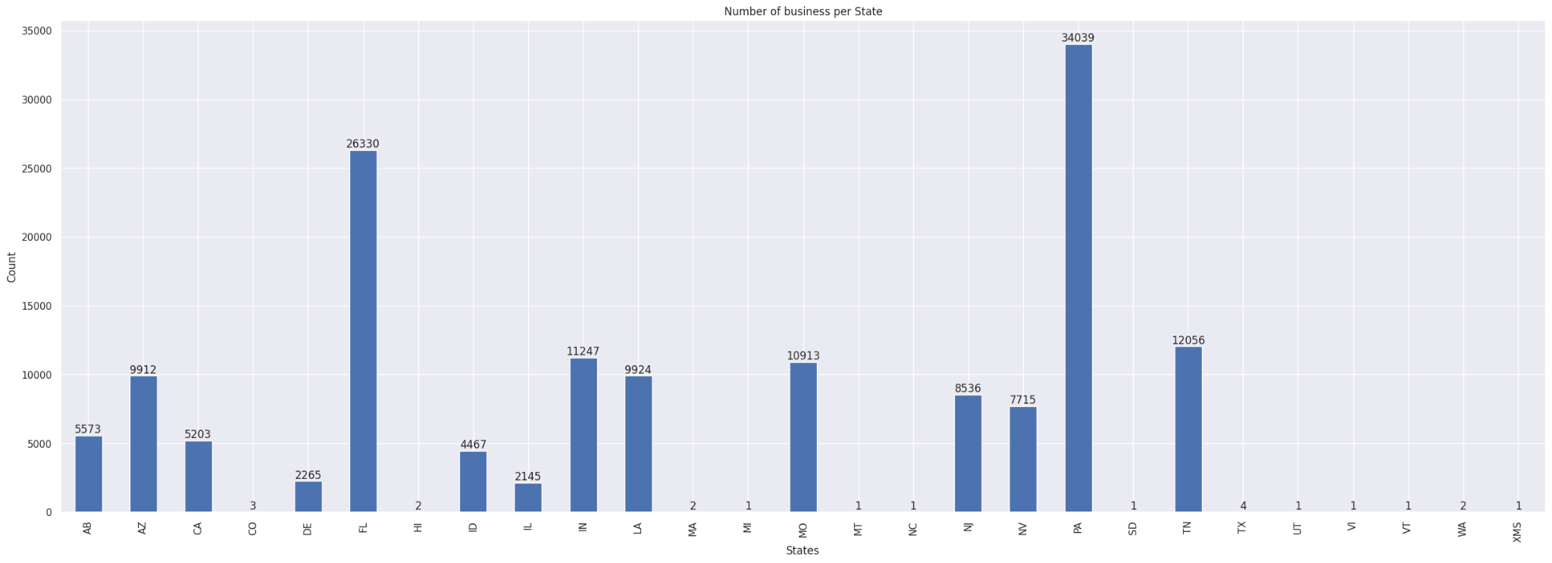
SC1015
Mini Project
Presentation
Number of Businesses per State
Notes:
Based on this bar chart, we can see that Pennsylvania, PA, has the highest number of businesses of 34039, followed by Florida, FL of 26330. We can also observe that there are MANY states that have less than 5 businesses as well.

Slide 31
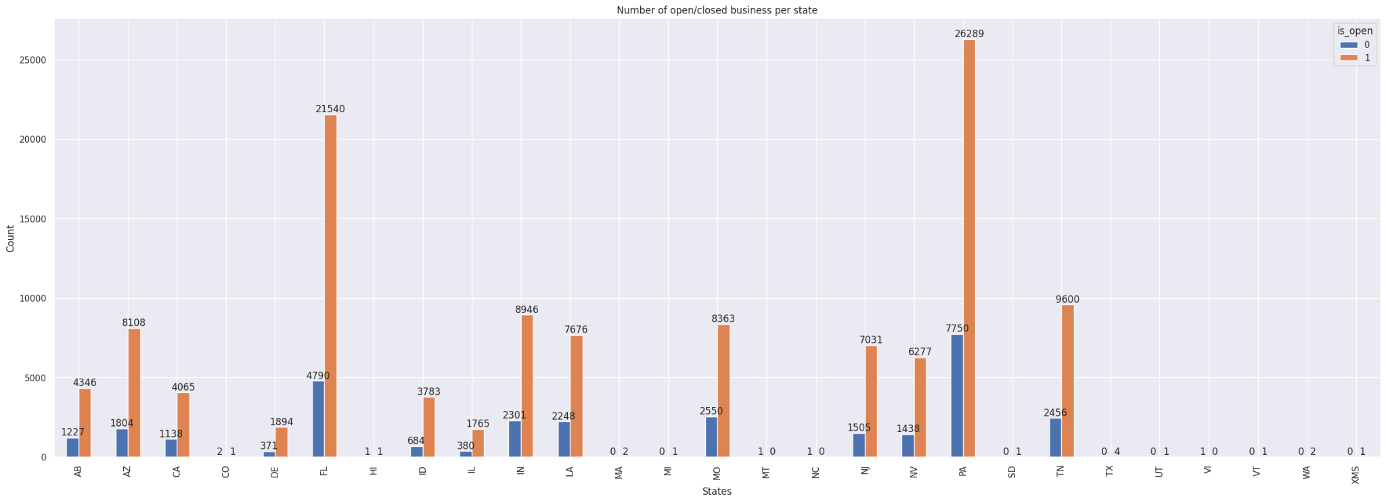
SC1015
Mini Project
Presentation
Number of open/closed business per State
Notes:
We then further split the businesses in each State into open and closed businesses. Similarly, we can see that Pennsylvania, PA, has the highest number of open businesses of 26389, followed by Florida, FL, of 21540.

Slide 32
SC1015
Mini Project
Presentation
Verdict
BEST STATES
WORST STATES
CO
MT
NC
VI
PA
FL
May not have covered all the businesses in the States
Missing States from the dataset
Notes:
Based on our analysis, we can conclude that the location does affect whether the business remains open. However, there are 13 States with less than 5 businesses in total and although there are 50 states in the US, but the yelp dataset only covers 11 metropolitan areas, so Yelp dataset has not cover every businesses in all areas and so this conclusion is only based on this current dataset analysis only and there might be possibility of other states that may have been potential location to open a business.

Slide 33

Company Name
Strategy Review
March 15, 2024
Machine Learning
Notes:
Next I will talk about ML modeling.

Slide 34
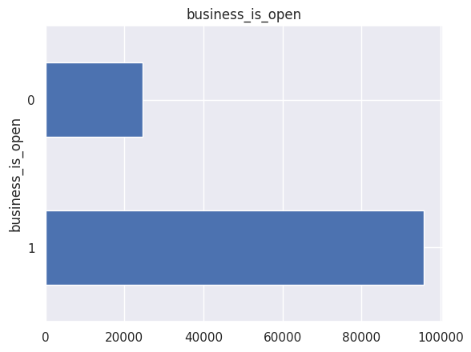
SC1015
Mini Project
Presentation
Class Imbalance
Undesirable Class Imbalance in target variable:
Model biased to overrepresented class.
Unreliable metrics (eg. Accuracy)
Undersampling of majority class done to correct Class Imbalance.
F1 Score selected as metrics due to robustness to Class Imbalance.
Notes:
First we have to correct the class imbalance anomaly in the data. Observing distribution of our target variable business_is_open, we can see a imbalance in of open (1) and closed (0) businesses. This imbalance is undesirable as it may cause the model to over bias towards the over represented class. Additionally class imbalance causes accuracy to become unreliable in determining actual model performance.
To combat imbalance, random under sampling of the majority class is done to balance out the no. of examples between classes. Additionally F1 score, t is selected as the replacement metric to evaluate candidate models due to its robustness to class imbalance.

Slide 35
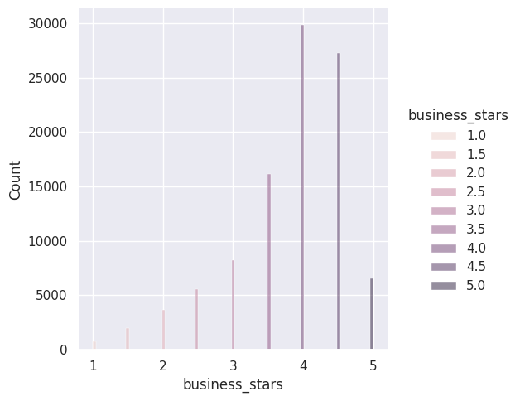
SC1015
Mini Project
Presentation
Feature
Engineering
Categorical Features One hot encoding vectorisation.
Numeric Features Standard deviation normalisation to make features scale invariant.
Business Stars Left skew corrected with np.exp2()
Business Categories Shrunk 1312 categories in 22 main categories to reduce cardinality for one hot encoding.
Notes:
One hot encoding is applied to categorical features to convert such features into numerical representation understood by ML models. Z score normalisation is applied to numeric features to ensure different value ranges are invariant to the model.
business_stars is left skewed, hence np.exp2() is applied to correct the skew.
EDA shows that business_categories has especially high cardinality:, We shrunk the 1312 combinations to 22 main main categories to avoid the curse of dimensionality.

Slide 36



SC1015
Mini Project
Presentation
Model Selection
Benchmarked Algorithms with K Fold cross validation (K=5).
Metric Models evaluated on F1 score metric.
0.797
0.811
0.813
Logistic Regression
Random Forest
XGBoost Classifier
Notes:
Now we will perform model selection by selecting the ML algorithm used in our model.
Logistic Regression, Random Forest & XGBoost models are trained on training data and evaluated with stratified K Fold cross validation (K=5) to benchmark their relative performance on the dataset.
Based on F1 score tabulated above, XGBoost is selected as the ML Algorithm as it achieves the highest F1 score.

Slide 37
SC1015
Mini Project
Presentation
Hyperparameter
Tuning
Hyperparameters
reg_alpha (0 - 1000) L1 regularization applied to model weights.
min_child_weight (0 - 120) Minimum weight of tree node, below which the XGBoost tree will not partition.
subsample (0.5 - 1) Below 1, XGBoost will randomly select a subset of the training data to train on.
learning_rate (0.1 - 0.5) Learning rate of each tree trained at the end of each boosting step.
n_estimators (1 - 4000) No. of rounds of boosting to perform.
60 Random Hyperparameter combinations evaluated to find optimal combination.
Some hyperparameters sampled on Logarithmic Scale to explore various orders of magnitudes.
Successive Halving Applied to eliminate unpromising combinations early (tournament).
Hyperparameter tuning improved F1: 0.813 ->0.820
Notes:
With the ML algorithm fixed, we can no proceed to tune it's parameters. 60 random samples of the following XGBoost Hyperparameters ⁴⁵ where evaluated on 80-20 train-validation split to find the optimal combination of Hyperparameters.
In particular, eg., learning_rate are explored on a logarithmic scale to completely explore various orders of magnitude for these Hyperparameters.
Successive Halving is applied to quickly try out hyperparameter combinations on a sample of the training data, eliminating unpromising combinations early tournament style. This reserves more computational resources to exploring promising hyperparameter combinations, identified initial trails, in later trials with more data, which are more computationally expensive.

Slide 38
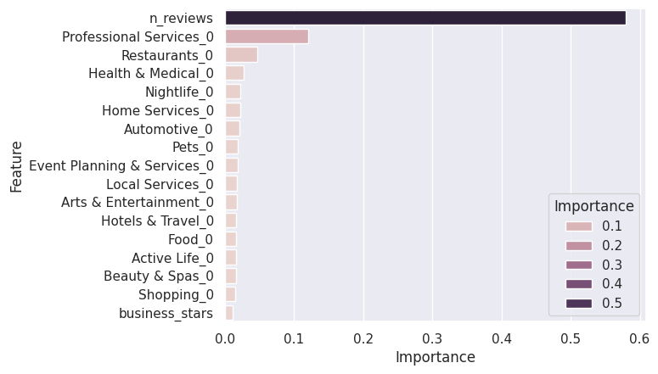
SC1015
Mini Project
Presentation
Insight: Feature Importance
Feature Importance values can be extracted from the model indicate how valuable a feature is.
No. of Reviews a business receives is most valuable feature in predicting survivability.
Notes:
Let's reverse engineer our model to answer our original question: “what does it take for a business to survive?”.
Feature Importance values can be extracted from the XGBoost model ranking how valuable each feature is to the model in making its prediction:
Observing the Feature Importance above, we conclude that the No. of reviews a business receives is the Key Predictor of a Yelp Business's ability to survive.
Joey will continue the presentation with our insights and recommendations.

Slide 39
SC1015
Mini Project
Presentation
Insights &
Recommendation

Slide 40
SC1015
Mini Project
Presentation
What Business Category Should We Open?
Home
Services
Health & Medical
Shopping
Notes:
Based on our analysis on the categories, we can conclude that if one were to open up a business, they should open a Shopping, Home Services or Health & Medical business. This is because it isn’t too competitive due to low number of open businesses, and there is also a high probability of keeping the business open.

Slide 41
SC1015
Mini Project
Presentation
What Makes a Yelp Business Stay Open?
Good Customer Service
Pennsylvania
&
Florida
Good Food
Notes:
To answer our problem statement, iif we want the business to stay open, we would need to focus on serving good food, assuming that it is a food establishment, and focus on good customer service. We should also consider opening our business in Pennsylvania & Florida for a better chance of staying open.

Slide 42


SC1015
Mini Project
Presentation
Recommendation
“
Incentivise customers to review business on Yelp!
— No. of reviews key indicator of Business survivability.
Notes:
One recommendation we would make is to incentivise customers to give reviews. From our analysis, we found a correlation where open businesses tend to have many reviews. One way to interpret this correlation would be because with more reviews, a business would know where to improve on to satisfy customers. Another interpretation would be if there are many good reviews, other people may be more likely to patronise the business.

Slide 43

Company Name
Strategy Review
March 15, 2024
THANK YOU
Notes:
Thank u

